Slide 1


Lending club – Risk Analytics
By Rohit Chaudhary and Giridhar Tarare

Slide 2
Our Understanding
Consumer finance company ( Banking and financial ) which specializes in lending various types of loans to urban customers. When the company receives a loan application, the company has to make a decision for loan approval based on the applicant’s profile.
Two types of risks are associated with the bank’s decision:
If the applicant is likely to repay the loan, then not approving the loan results in a loss of business to the company
If the applicant is not likely to repay the loan, i.e. he/she is likely to default, then approving the loan may lead to a financial loss for the company
Two type of decision will take for any loan application as “Loan Accepted “ and “Loan Rejected”
Identify the loan Accepted and load Rejected applications & criteria
Loan Accepted
Loan Rejected
Fully paid: Applicant has fully paid the loan (the principal and the interest rate)
Current: Applicant is in the process of paying the instalments, i.e. the tenure of the loan is not yet completed. These candidates are not labelled as 'defaulted‘
Charged-off: Applicant has not paid the instalments in due time for a long period of time, i.e. he/she has defaulted on the loan
The company had rejected the loan (because the candidate does not meet their requirements etc.). Since the loan was rejected, there is no transactional history of those applicants with the company and so this data is not available with the company (and thus in this dataset)

Slide 3
Business Objective and Scope
Analysis & Identify these risky loan applicants profiles and loan application:
Borrowers can easily access lower interest rate loans through a fast online interface.
Company wants to understand the driving factors (or driver variables) behind loan default
Advised to independently research a little about risk analytics (understanding the types of variables and their significance should be enough).
Scope : Risk Analytics
Mention the problem statement and the analysis approach briefly
Understand the data and make data smart ( data cleaning , data standardized ,removed redundant columns, etc.)
Explain the results of univariate, bivariate analysis etc. in business terms
Include visualizations and summaries the most important results in the presentation

Slide 4
Data Understanding and Data Cleaning and Manipulation

Slide 5
Implementation Summary : Risk Analytics ( Loan Applications)
Data Load - Loan data and related dictionary data
Load data into Data frame and understand the data & Columns
Data Cleaning and standardized ( removed unwanted columns, rows, removed null values from columns, amount percentage , zip code etc.)
Check the number of null values in the columns
Dropping columns & rows with all the Null values
Deleting all the columns which are not required and having only unique value and all unique values like id, member_id, url etc.
Dropping rows with null values
Interest rate column and removing % and converting to float type for analysis
Validate the loan amount and Funded amount to identify any discrepancy in amounts for approval process.
Univariate Analysis for Risk Analytics
Bivariate Analysis for Risk Analytics
Multivariate Analysis for Risk Analytics

Slide 6
Data Analysis

Slide 7
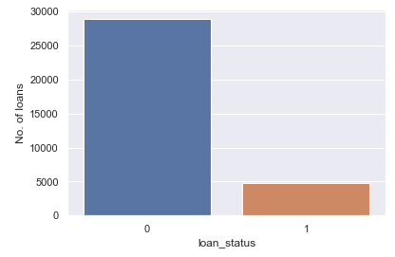
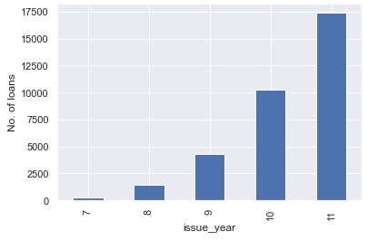
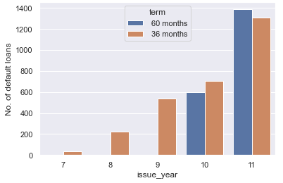
Univariate Analysis
Loan defaulted by loan applicants [0 -28873 and 1- 4794 ]
Distribution of loans over the year
Distribution of loan compared to term of loan (60 & 30 months )

Slide 8
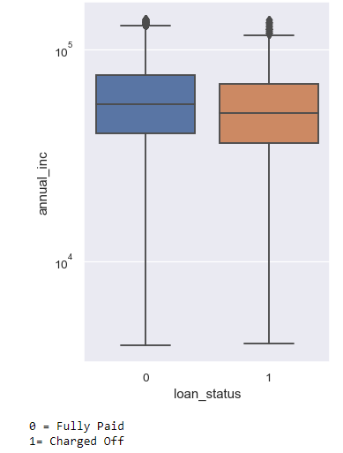
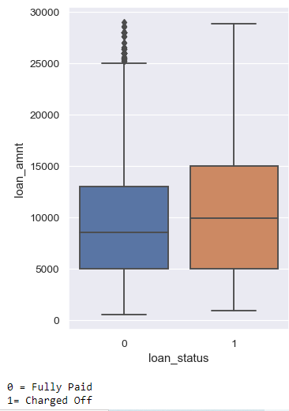
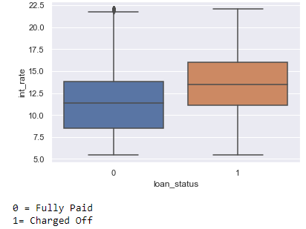
Univariate Analysis continue…
Loan amount and loan status
Interest rate will be low other then providers
Annual income on log scale of loan applicants for loan paid off and default loan

Slide 9
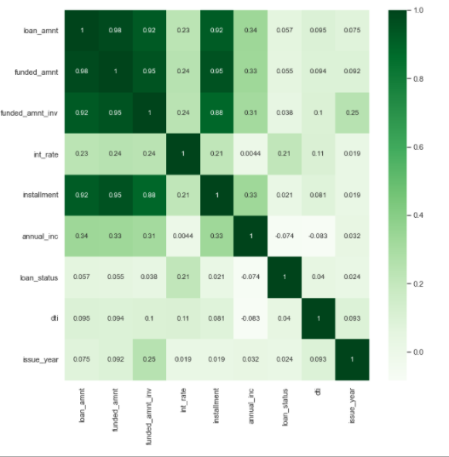
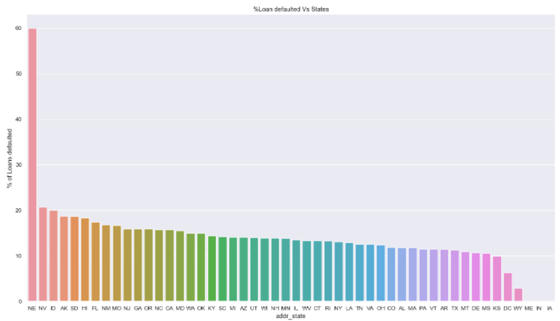
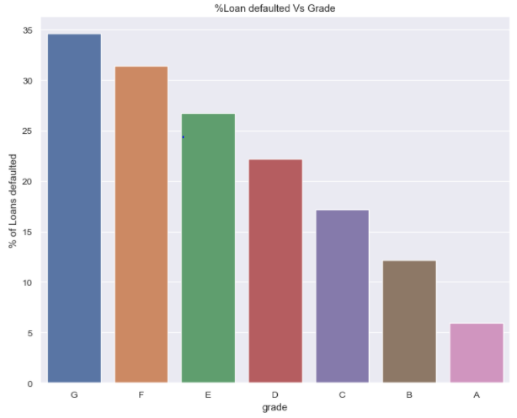
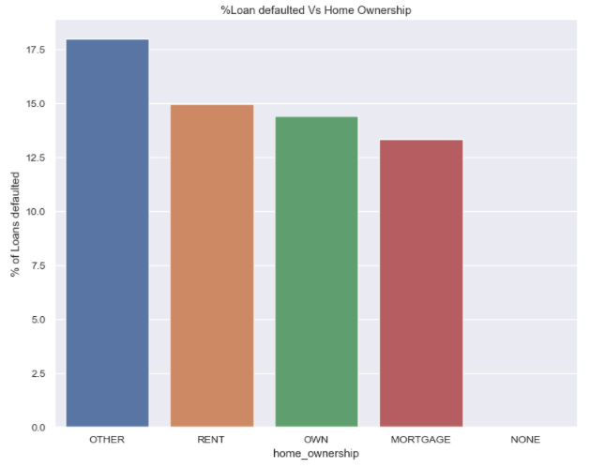
Bivariate Analysis
Funded amount and funded amount by investor has a strong correlation with each other and with loan amount, therefore theses two columns can be dropped
Seems like NE is having maximum loan defaults among all the states. Let us check no. of loans counts in NE
As apparent from above, grade G loans are having highest default rate
Loan defaulted vs home ownership

Slide 10
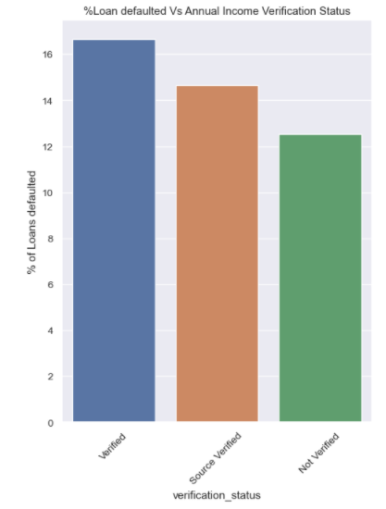
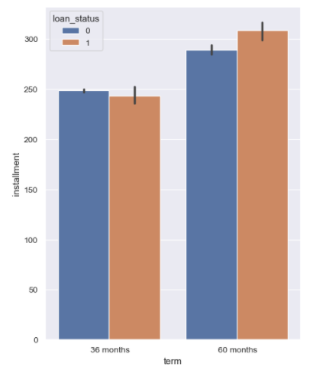
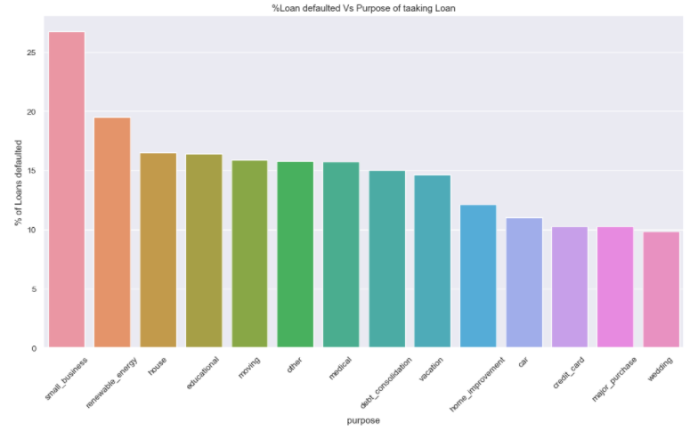
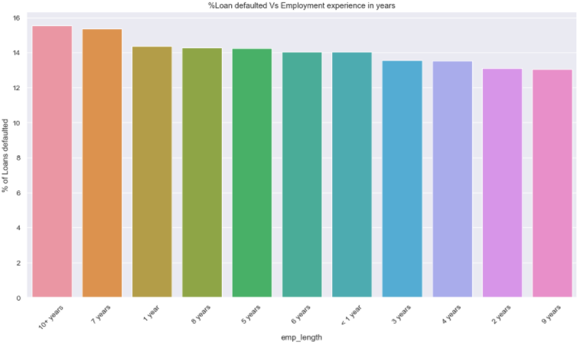
Bivariate Analysis Continue..
Loan defaulted vs Purpose of loan taking
Verification status for all defaulted customer’s
Loan Status of the months of 30 & 60 months
Employees with experience more that 10 years are more likely to default loans.

Slide 11
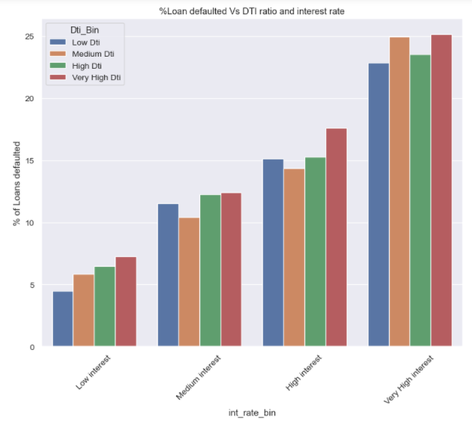
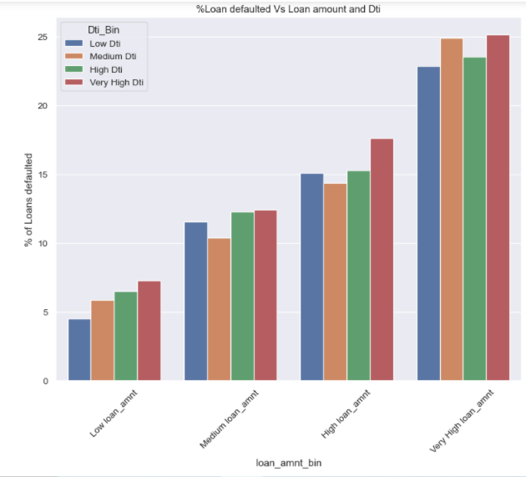
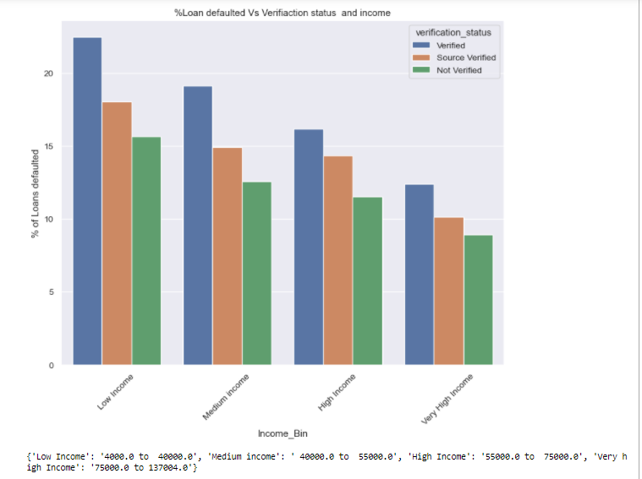
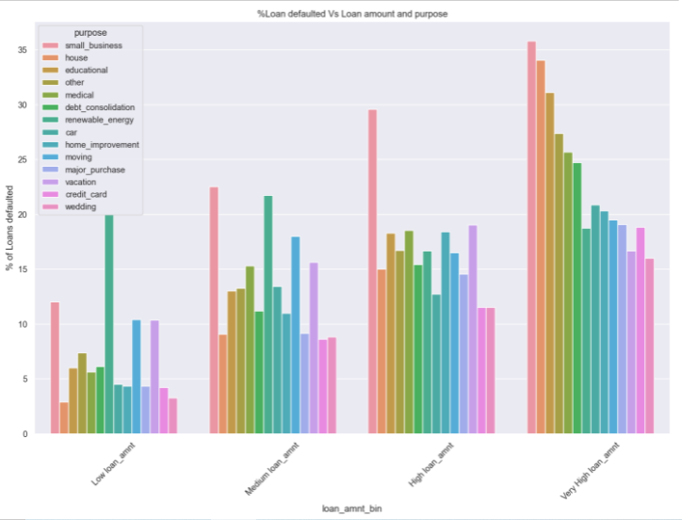
Multivariate analysis
High interest rate, medium DTI is yielding almost same default rate as very high DTI
Loan defaulted vs Loan amount and DTI
Verification status : Variation is as per earlier variation brought out above. No abnormality observed.
Combined effect of Loan amount and purpose on default % - Loan amount bin vs Purpose

Slide 12
Conclusion
No. of loans being offered are in an increasing trend from 2007 to 2011 and so does the loan default rate.
Default rate is much higher for 60 months term compared to 36 month term ever since its inception in 2010. In fact default rate is on decreasing trend for 36 months term may be due to increasing 60 month term loan. Therefore no. of 60 months term loan may be reduced.
It is observed that there is higher tendency of loan default when loan is being offered for purpose of small business, therefore no. of loans to small business may be reduced or offered after due diligence.
Less defaults are being observed for lower interest rate irrespective of dti, therefore, low interest rate loans may be given in more nos.. Also. Loans are not being offered for higher dti(> ~25%) and higher interest rate (> ~15%) may be due to high default risk associated with such loans.
For low and small loan amount default rates are higher for debt consolidation purpose of loan and also for very high loan amount, house and education loan are having max default rate after small business.
In case of very high interest rate, medium DTI is yielding almost same default rate as very high DTI.

Slide 13
Recommendation
Adjust the operating principles with market and investment shifts.
Reduce the risk of defaulter and proactively get applicant’s other data to validate for loan approve or reject.
Increment the revenues of bank because of less defaulter and regular payment by customers.

Slide 14
Thank you!

